Slide 1



@torokagoston agostontorok.github.io @tony_does_science

Slide 2
hello.
Notes:
Hello everyone. Let me start this talk in a little peculiar way, namely with an anouncement. Today, we are introducing the new phone 8

Slide 3
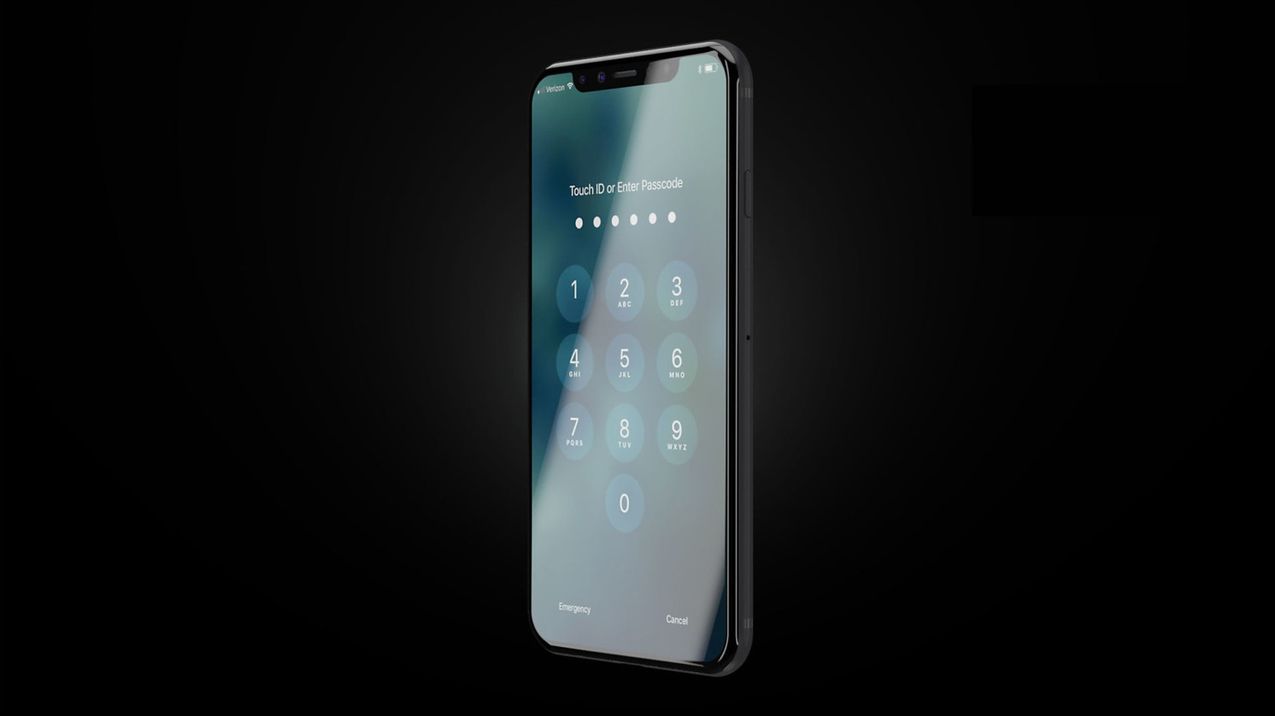
Phone 8
Better camera
Better features
Longer battery life
Larger screen
Notes:
This is a breakthrough product, it has better camera, better features, longer battery life and a larger screen. From these key changes I would like to talk about probably the most important one, the screen

Slide 4
Phone 8
Better camera
Better features
Longer battery life
Larger screen
Notes:
This is my phone, it has a 5 inch display and I often feel it small: My typing speed is XX on this phone, this is faster than the average which is XX worldwide. However, I feel less productive compared to my desktop, where I can easily reach XX keys per minute. Considering that I have
https://www.google.hu/search?safe=off&biw=1422&bih=655&tbm=isch&sa=1&q=phone+in+pocket&oq=phone+in+pocket&gs_l=psy-ab.3..0i19k1l3j0i7i30i19k1.3551.5000.0.5321.5.4.1.0.0.0.94.310.4.4.0....0...1.1.64.psy-ab..0.5.315.cbP1kyb1E3o

Slide 5
Picture of a phone typing watching video on a phone multitasking on a phone

Slide 6
The neuroscience of virtual reality​
Notes:
I’ve always considered myself more of an applied scientist, interested in problems that would make people’s life easier, better and happier

Slide 7
VR is ..

Slide 8
VR is a tech challenge
Notes:
Needs to be cheaper Needs content Needs to be mobile - miniaturization
5g Speed
Prepared society (security)
•Consumers don’t really care about how difficult was the problem that you solved

Slide 9
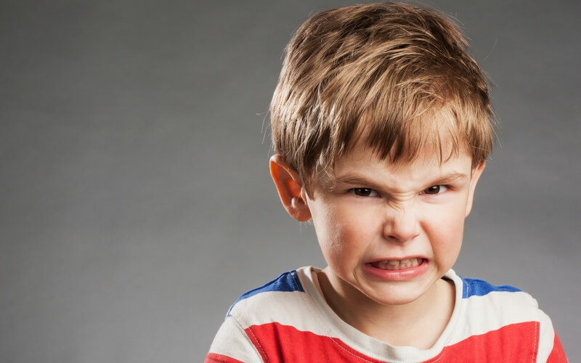
VR is a tech challenge
Just let me play Angry Birds on my Oculus!
Notes:
Needs to be cheaper Needs content Needs to be mobile - miniaturization
5g Speed
Prepared society (security)
•Consumers don’t really care about how difficult was the problem that you solved

Slide 10
VR is ..

Slide 11
VR is the key to everything
Notes:
Needs to be cheaper Needs content Needs to be mobile - miniaturization
5g Speed
Prepared society (security)
•Consumers don’t really care about how difficult was the problem that you solved

Slide 12
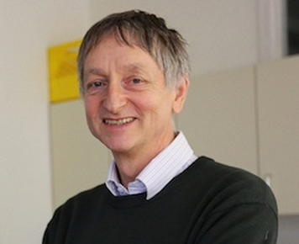
VR is the key to everything
Of course not, deep learning is!
Notes:
Needs to be cheaper Needs content Needs to be mobile - miniaturization
5g Speed
Prepared society (security)
•Consumers don’t really care about how difficult was the problem that you solved

Slide 13
VR is ..

Slide 14
VR is sg. I should invest in
Notes:
Needs to be cheaper Needs content Needs to be mobile - miniaturization
5g Speed
Prepared society (security)
•Consumers don’t really care about how difficult was the problem that you solved

Slide 15
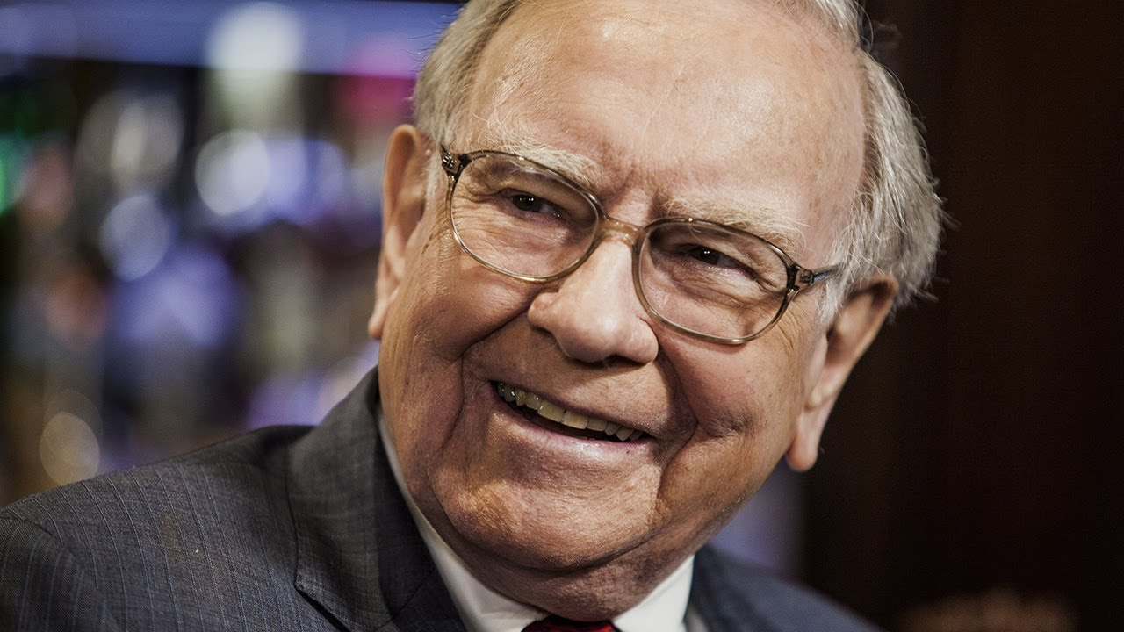
VR is sg. I should invest in
So you’ve got a hot tip for me?
Notes:
Needs to be cheaper Needs content Needs to be mobile - miniaturization
5g Speed
Prepared society (security)
•Consumers don’t really care about how difficult was the problem that you solved

Slide 16
VR is ..

Slide 17
VR is the new interface.
Notes:
Needs to be cheaper Needs content Needs to be mobile - miniaturization
5g Speed
Prepared society (security)
•Consumers don’t really care about how difficult was the problem that you solved

Slide 18
VR is the new interface.
Notes:
Needs to be cheaper Needs content Needs to be mobile - miniaturization
5g Speed
Prepared society (security)
•Consumers don’t really care about how difficult was the problem that you solved

Slide 19
VR is the new interface.
Intuitive
Notes:
Needs to be cheaper Needs content Needs to be mobile - miniaturization
5g Speed
Prepared society (security)
•Consumers don’t really care about how difficult was the problem that you solved

Slide 20
VR is the new interface.
Intuitive
Organic
Notes:
Needs to be cheaper Needs content Needs to be mobile - miniaturization
5g Speed
Prepared society (security)
•Consumers don’t really care about how difficult was the problem that you solved

Slide 21
VR is the new interface.
Intuitive
Organic
Unconstrained
Notes:
Needs to be cheaper Needs content Needs to be mobile - miniaturization
5g Speed
Prepared society (security)
•Consumers don’t really care about how difficult was the problem that you solved

Slide 22

in·tu·i·tive ​
intuitive​
\in-ˈtü-ə-tiv, -ˈtyü-\​
adjective
known or perceived by intuition : directly apprehended
readily learned or understood

Slide 23
Look at oculus

Slide 24
and woman

Slide 25
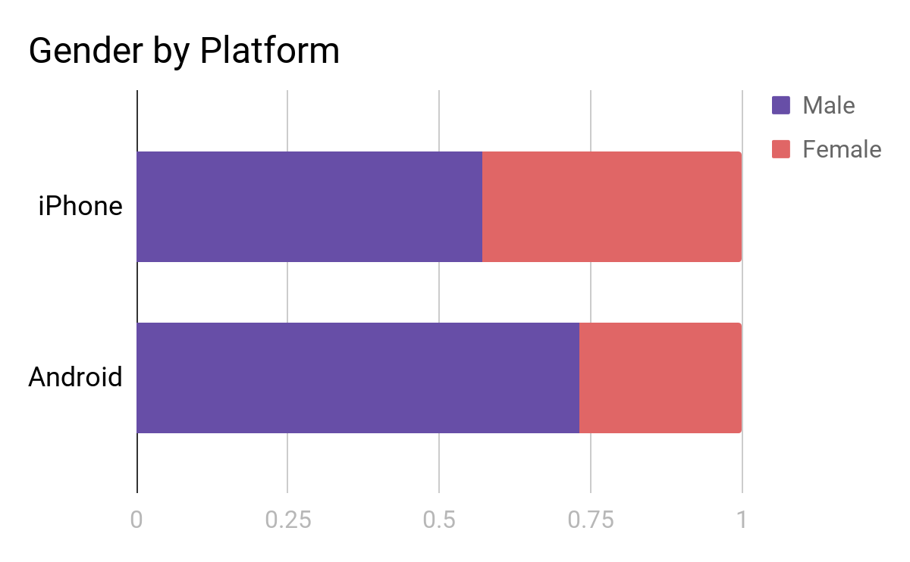
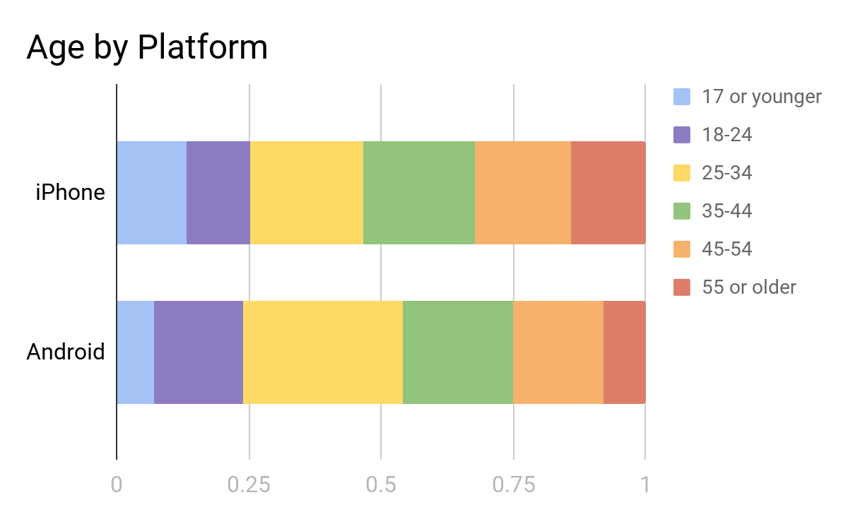
Early adopters
source admob

Slide 26
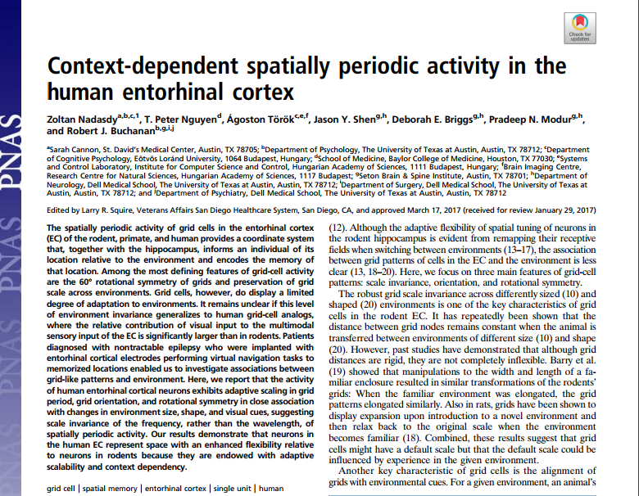
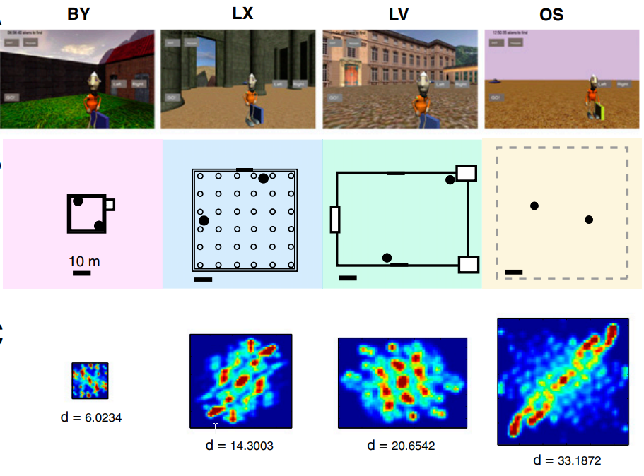
Grid cells adapt to environment size in humans
Notes:
Online pdf

Slide 27
and woman

Slide 28
show the other players

Slide 29
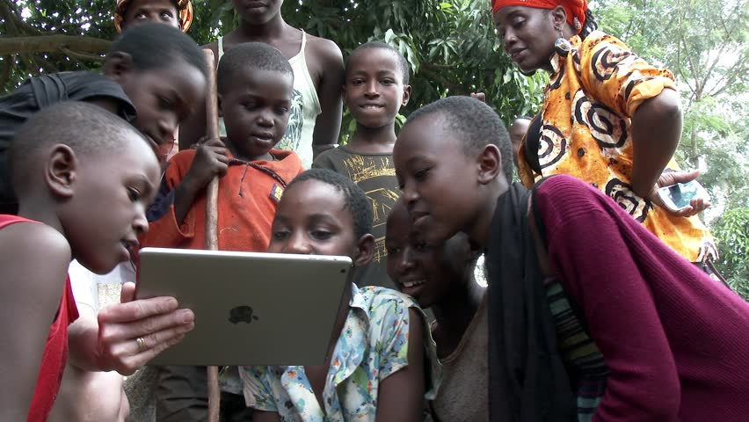
Notes:
Show the game
Picture of me showing the game to my grandma
Family - developmental aspects
The question of interaction
You should never spend time on inventing the wheel
What should you show

Slide 30
“...think about lifting your right arm if you want to move forward…”

Slide 31
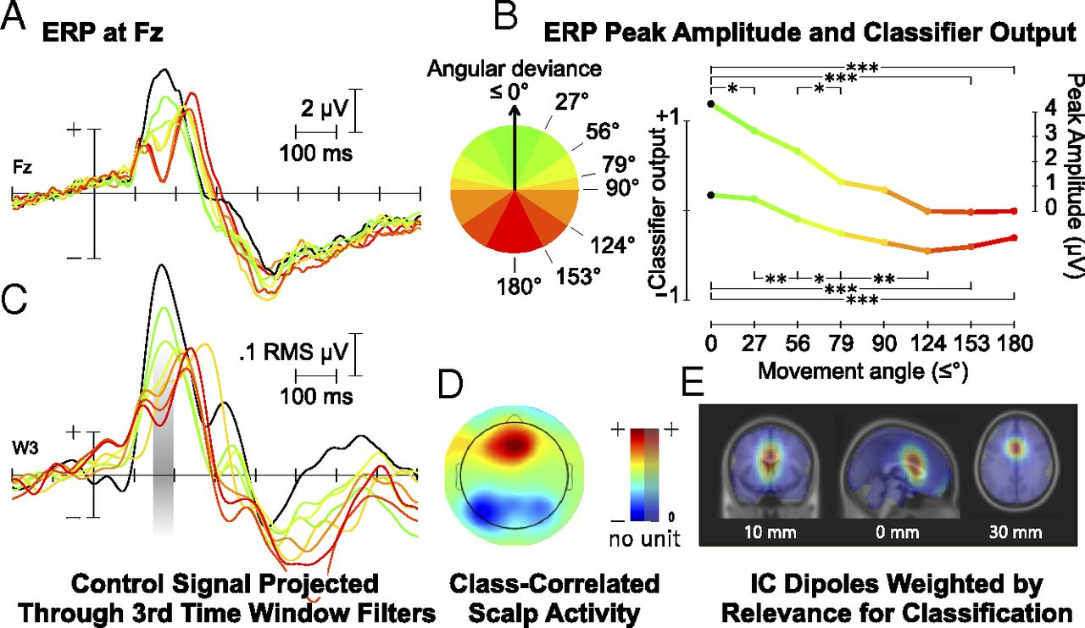
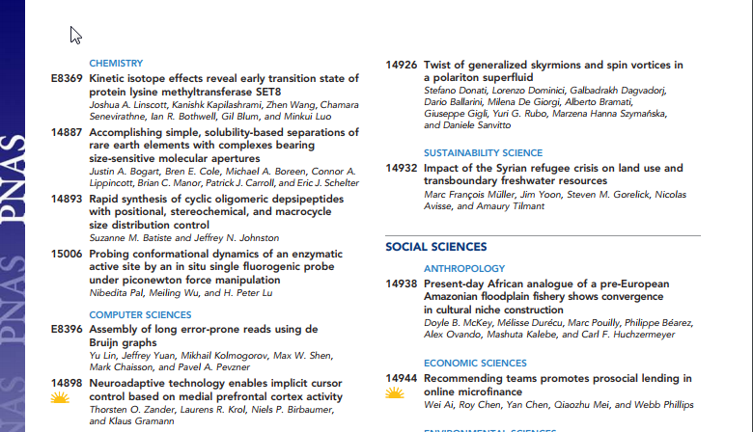
Zander et al. PNAS 2016
Notes:
Online pdf

Slide 32
focus on finding the wheel
instead of reinventing it

Slide 33
or·gan·ic ​
organic​
\ȯr-ˈga-nik\​
adjective
relating to, or arising in a bodily organ
relating to, or derived from living organisms
forming an integral element of a whole

Slide 34
close your eyes, please

Slide 36
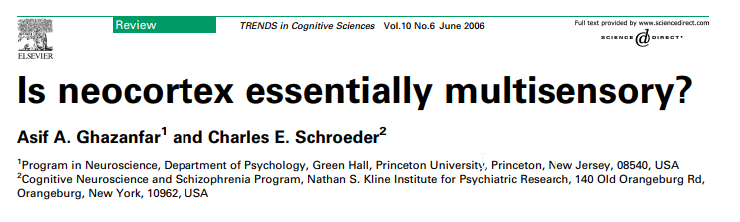
Notes:
Online pdf

Slide 37
so much ...
Notes:
That even what we believe is unisensory is actually multisensory

Slide 38
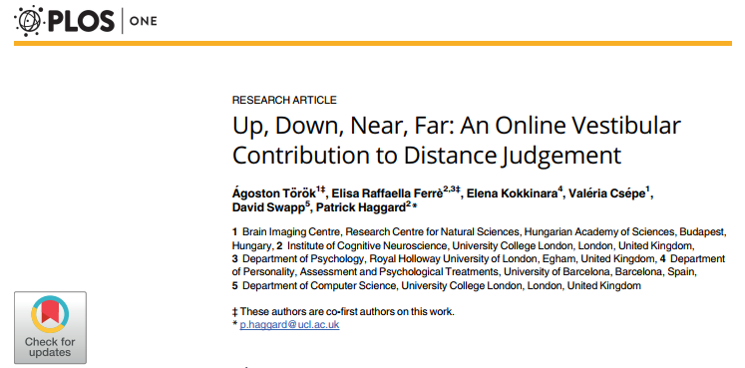
Notes:
Online pdf

Slide 39
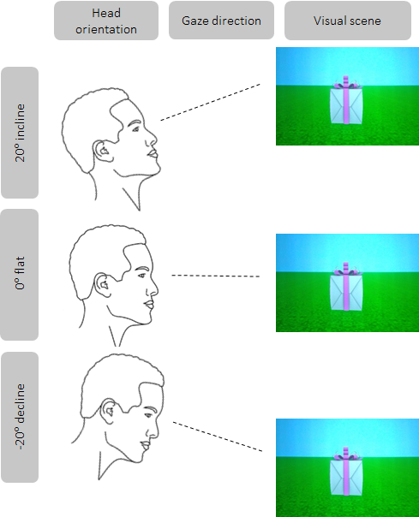
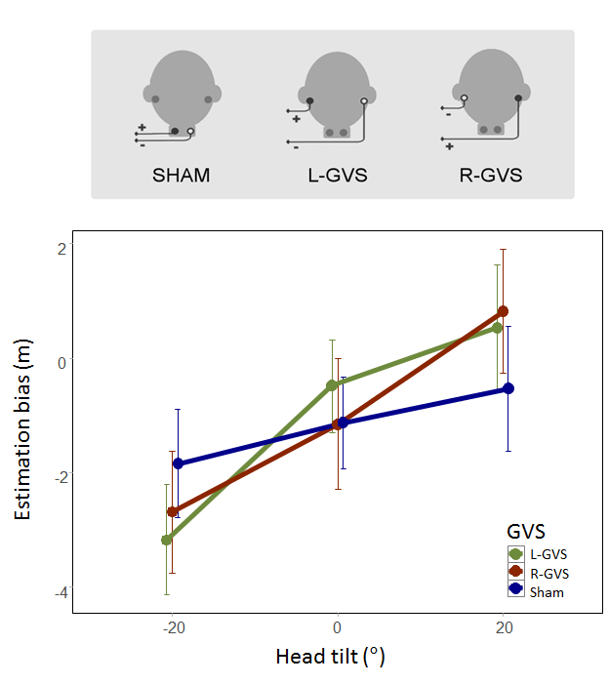

Slide 40
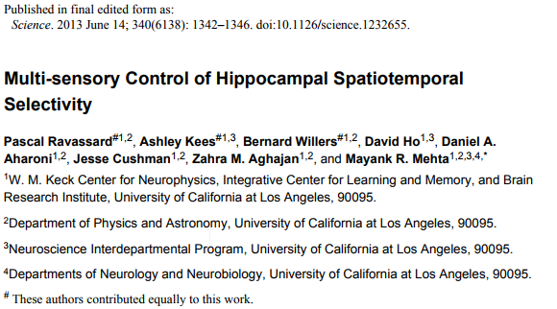

Slide 41
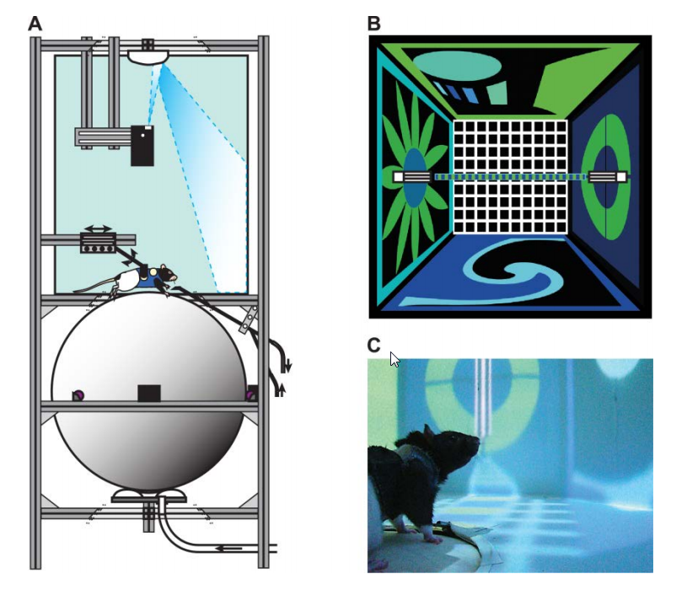

Slide 42
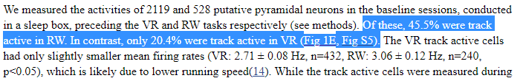

Slide 43
going fully virtual?

Slide 44
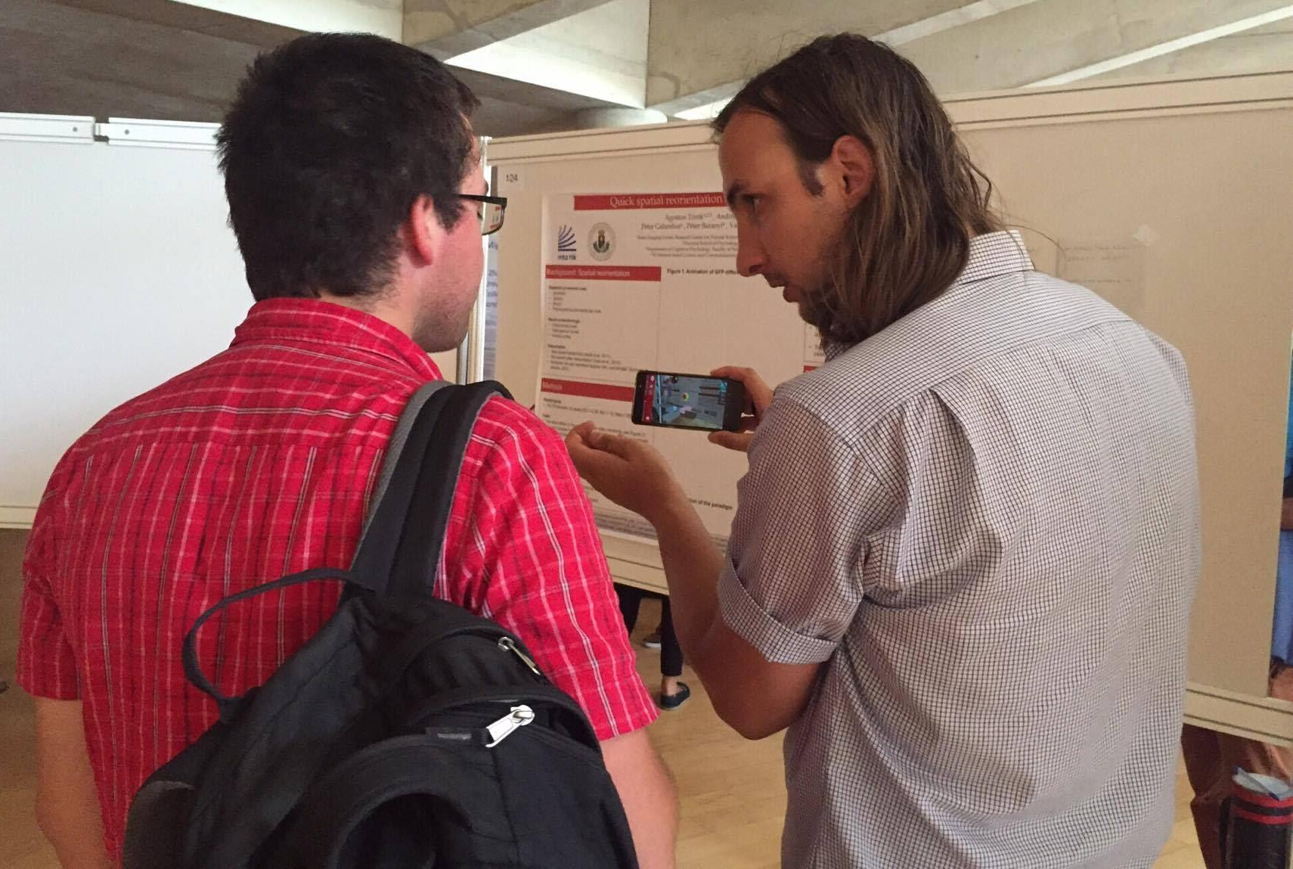
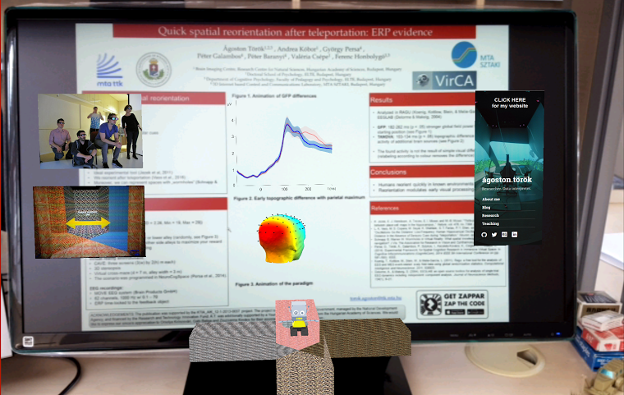
Notes:
Talk about Magic Leap

Slide 45
more than meets the eyes

Slide 46
un·con·strained ​
unconstrained​
\ˌən-kən-ˈstrānd\
adjective
not held back or constrained
not restricted or limited

Slide 47

Notes:
In order to create a radically new and better interface we have to think outside the box, and sometimes even forget that there was ever any box

Slide 49
old habits die hard

Slide 50
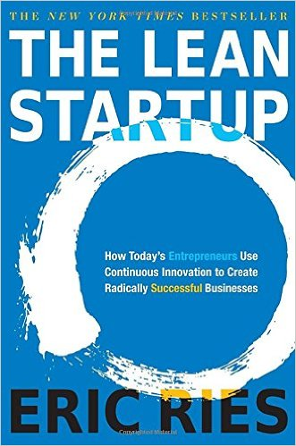

Slide 51



Slide 52
Start in south

Slide 53
Turn left

Slide 54
Teleport to North

Slide 55
Turn right

Slide 56
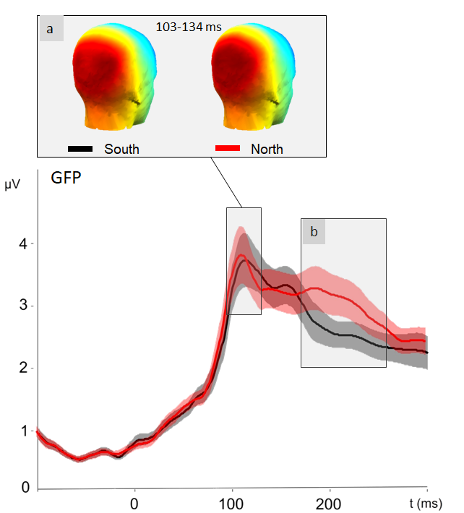
Notes:
Show the experiment

Slide 57
conclusions.

